Slide 1
CHANDIDAS MAHAVIDYALAYA
DEPARTMENT OF GEOGRAPHY
TOPIC:- IRON ORE RESOURCE OF INDIA
Prof.- Indrajit Mandal

Slide 2
What Is Iron?
Iron is a metallic element that is very chemically reactive, particularly when it interacts with oxygen. That's why iron metal rusts, and why your hemoglobin carries oxygen. Iron is one of the most common elements on Earth and in space.
All of the iron atoms in the universe formed in the cores of stars during the final stages of fusion and then launched into space by stellar explosions. Iron is the single most common element composing our planet, although most of it by mass is found far below the surface in the Earth's core.
Iron is the fourth-most abundant element in the Earth's crust, after silicon, oxygen and aluminum. It is present in nearly every rock of the crust and mantle as a chemical component of hundreds of different minerals.

Slide 3
WHAT IS IRON ORE?
Iron ores are rocks and minerals from which metallic iron can be economically extracted. The ores are usually rich in iron oxides and vary in colour from dark grey, bright yellow, or deep purple to rusty red. The iron itself is usually found in the form of magnetite, hematite, goethite, limonite or siderite.

Slide 4
Types of Iron Ore
Magnetite,
Hematite,
Limonite &
Siderite

Slide 5
Magnetite
Black ore; 60 to 70 per cent metallic content.
Dharward and Cuddapah systems.
Magnetic quality.
Karnataka, Andhra Pradesh, Rajasthan, Tamil Nadu and Kerala.

Slide 6
Haematite
Reddish; best quality; 70 per cent metallic content.
Found in Dharwad and Cuddapah rock systems of the peninsular India.
80 per cent of haematite reserves are in Odisha, Jharkhand, Chhattisgarh and Andhra Pradesh.
In the western section, Karnataka, Maharashtra and Goa has this kind of ore.

Slide 7
Limonite
Inferior ores; yellowish in colour; 40 to 60 per cent iron metal.
Damuda series in Raniganj coal field, Garhwal in Uttarakhand, Mirzapur in Uttar Pradesh and Kangra valley of Himachal Pradesh.
Advantage == open cast mines == easy and cheap mining.

Slide 8
Siderite
‘Iron carbonate’; inferior quality; less than 40 per cent iron.
Contains many impurities {previous post}; mining is not economically variable.
However, it is self-fluxing due to presence of lime.

Slide 9
Iron Ore Distribution in India
Hematite and magnetite are the two most important iron ores in India
Exact Numbers not important. Remember 1st and 2nd position.
Haematite
Magnetite
Reserves
~18,000 million tonnes
Which type of iron ore is abundant in India?
1. Haematite
2. Magnetite
~10,500 million tonnes

Slide 10
Major states
Odisha 33%
Jharkhand 26%
Chhattisgarh 18%
Rest in Andhra Pradesh, Assam, Bihar, Maharashtra, MP, Rajasthan, UP
Karnataka 73%
Andhra Pradesh 14%
Rajasthan 5%
TN 4.9%
Rest in Assam, Bihar, Goa, Jharkhand, Kerala, MH, Meghalaya and Nagaland

Slide 11
Q1. Statements
Karnataka has more than half of the reserves of magnetite ore in India.
Jharkhand has the highest reserves of hematite ore in India.
Which of the above are true?
Both
1 only
2 only
None
Iron Ore in Orissa
The ores are rich in haematites.
India’s richest haematite deposits are located in Barabil-Koira valley.
Others: Sundargarh, Mayurbhanj, Cuttack, Sambalpur, Keonjhar and Koraput districts.

Slide 12
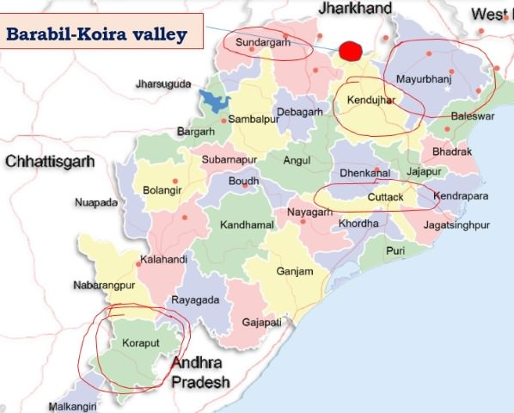

Slide 13
Iron Ore in Chhattisgarh
Bailadila mine is the largest mechanised mine in Asia [Ore benefication only done here]
A 270 km long slurry (a semi-liquid mixture) pipeline from the Bailadila to Vizag plant transports the ore slurry.
Smelting is done in Vizag [Vishakhapatnam] iron and steel factory.
Bailadila’s high grade ore is exported through Vishakhapatnam to Japan [No iron ore in Japan. But market is huge due to automobile industry] and other countries.
The Dalli-Rajhara range is 32 km long [ferrous content 68-69 per cent] range with significant reserves.

Slide 14
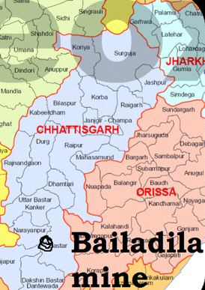

Slide 15
Iron Ore in Jharkhand
25 per cent of reserves.
First mine in Singhbhum district in 1904.
Iron ore of here is of highest quality and will last for hundreds of years.
Noamandi mines in Singhbhum are the richest.
Magnetite ores occur near Daltenganj in Palamu district.

Slide 16
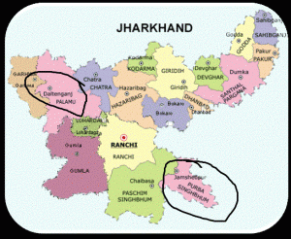

Slide 17
Iron Ore in Karnataka
Iron ores are widely distributed.
High grade ore deposits are those of Kemmangundi in Bababudan hills of Chikmagalur district and Sandur and Hospet in Bellary [Lot of Mining Mafia].
Most of the ores are high grade haematite and magnetite.

Slide 18
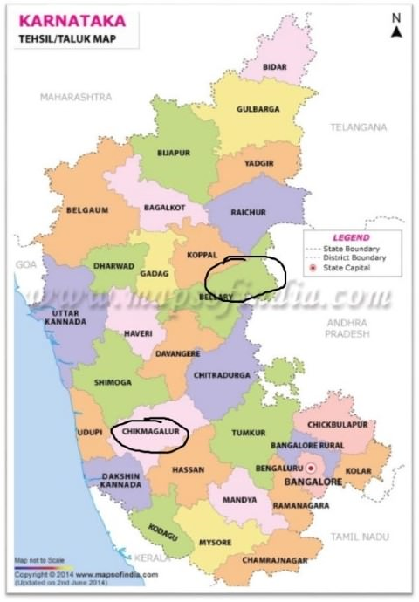

Slide 19
Iron Ore in other states
Andhra Pradesh (1.02%): Kurnool, Guntur, Cuddapah, Ananthapur, Nellore.
Maharashtra (0.88%): Chandrapur, Ratnagiri and Sindhudurg.
Madhya Pradesh (0.66%).
Tamilnadu: Salem, Tiruchirapalli, Coimbatore, Madurai etc.
Rajasthan: Jaipur, Alwar, Sikar, Bundi, Bhilwara.
Uttar Pradesh: Mirzapur.

Slide 20
Uttaranchal: Garhwal, Almora, Nainital.
Himachal Pradesh: Kangra and Mandi.
Haryana: Mahendragarh.
West Bengal: Burdwan, Birbhum, Darjeeling.
Jammu and Kashmir: Udhampur and Jammu.
Gujarat: Bhavnagar, Junagadh, Vadodara.
Kerala: Kozhikode.

